Slide 1


Searching for differentially expressed genes in 7 types of Mus Musculus cells.
This Photo by Unknown Author is licensed under CC BY-NC

Slide 2
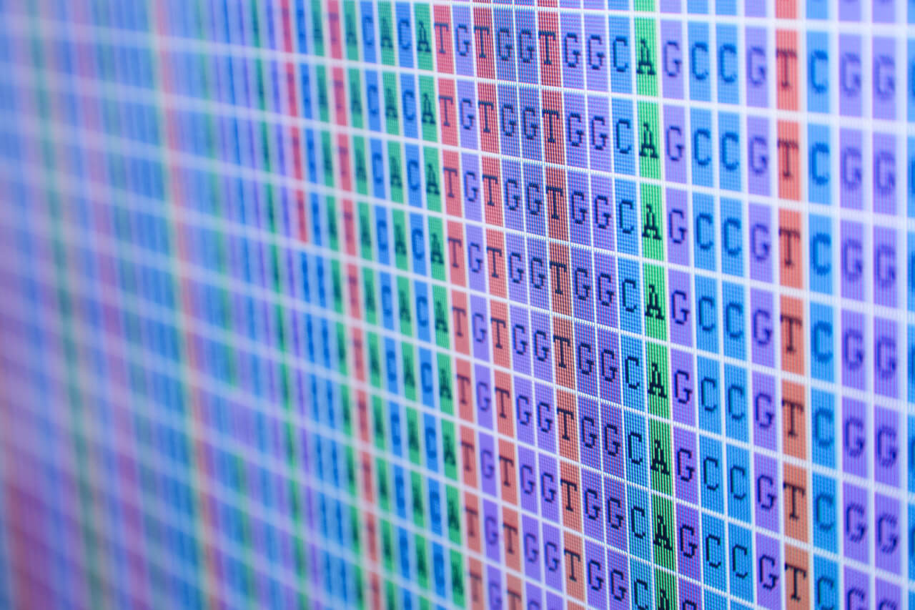
Dataset
For the current project a dataset from Tabula Muris was used. Tabula Muris is a collection of single-cell transcriptome data from Mus musculus (House mouse), containing nearly 100000 cells from 20 organs and tissues.
This Photo by Unknown Author is licensed under CC BY-NC

Slide 3
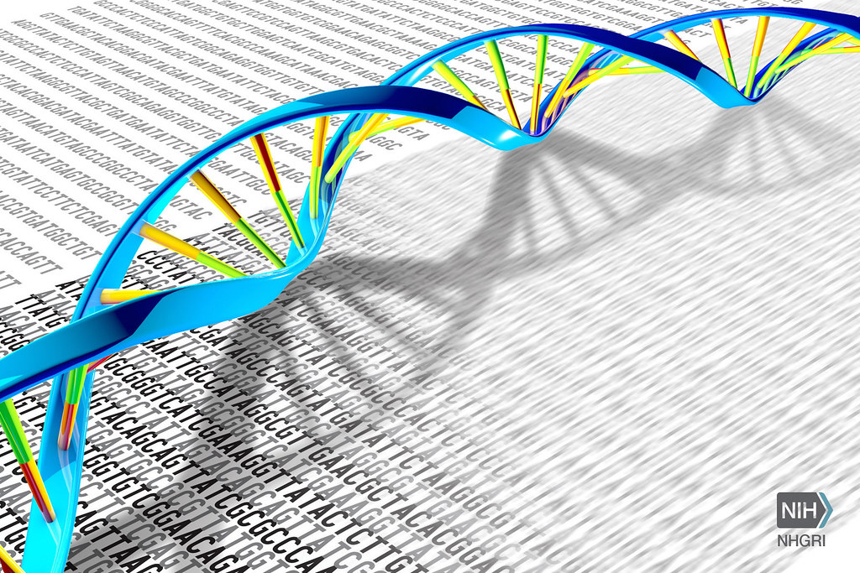
Methods: The Scanpy library was used for the analysis
Dimensionality Reduction
Principal Component Analysis (PCA)
Uniform Manifold Approximation and Projection (UMAP)
Clustering
K-Means
Louvain
Hierarchical clustering analysis to visualize differentially expressed genes
This Photo by Unknown Author is licensed under CC BY

Slide 4
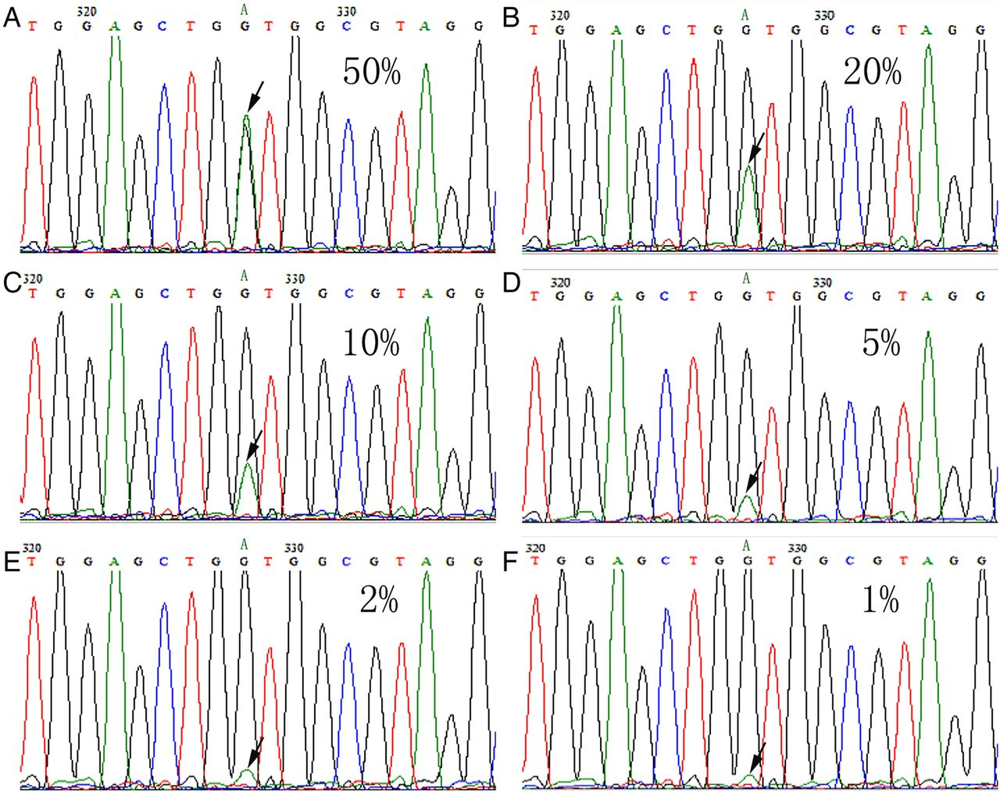
Workflow of the analysis
Downloading data and metadata
EDA of the downloaded data
Generation of an annotated object
Visualization of highly expressed genes
Calculation of quality control metrics
Visualization of some quality control metrics
Filtering
Post-filtering QC
Logarithmizing and scaling data
PCA (dimensionality reduction)
UMAP (dimensionality reduction) on top of PCA
K means on top of UMAP
Louvaine on top of MAP
Visualizing genes ranked for their importance for a cell type (dendrogram)
Printing genes ranked for their importance for a cell in a tabular form.
This Photo by Unknown Author is licensed under CC BY-NC

Slide 5
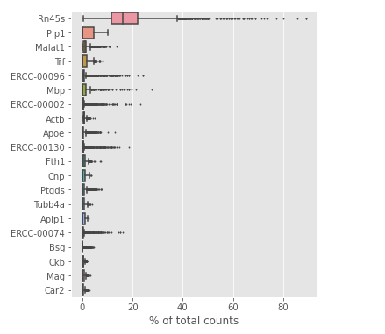
the top 20 highest expressed genes

Slide 6
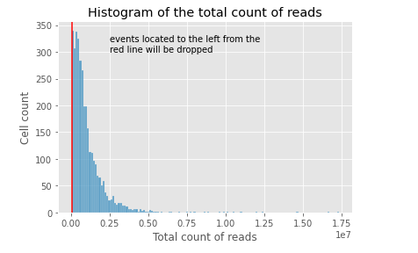
Histogram of the total counts of reads per cell

Slide 7
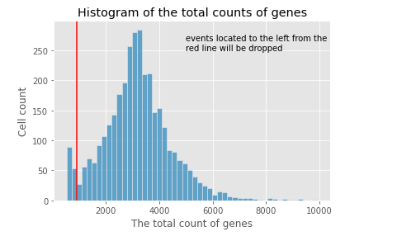
Histogram of the total counts of detected genes per cell

Slide 8
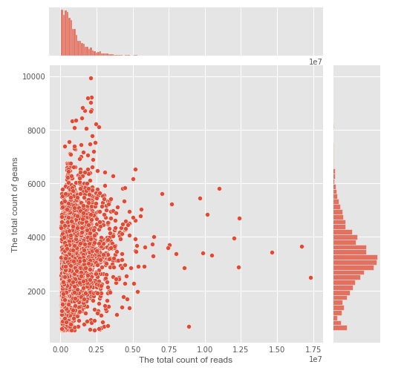
scatter plot of the total number of reads per cell vs total number of genes per cell

Slide 9
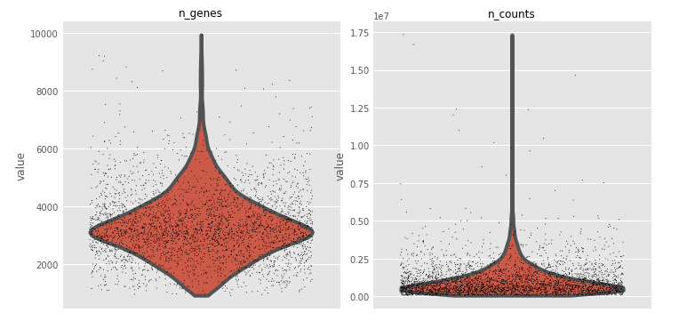
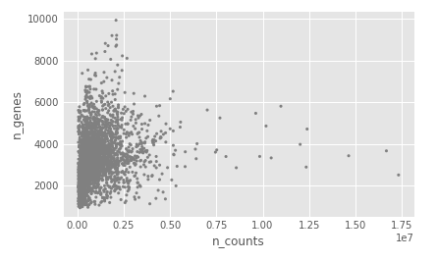
Quality control check of the counts post-filtering
A
A.
the violin plot of the total number of genes and the total number of read count per cell.
scatter plot of the total number of reads vs the total number of genes per cell
B

Slide 10
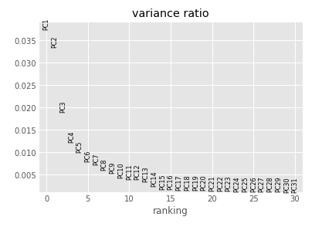
explained variance ratio by each PCA component

Slide 11
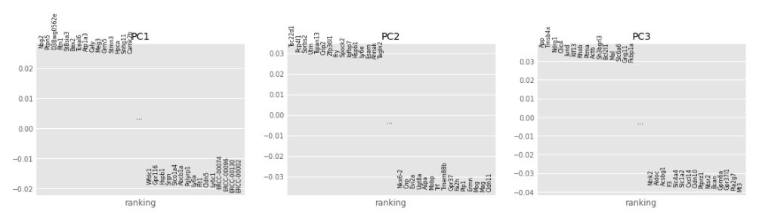
the most impactful genes on the FIRST THREE PCA components

Slide 12
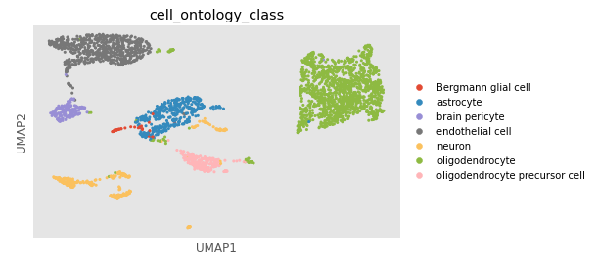
graph in UMAP coordinates of 7 different types of MOUSE cells

Slide 13
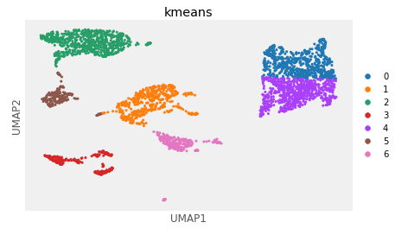
K-Means clustering of cells using UMAP components (ADJUSTED RAND SCORE=0.65)

Slide 14
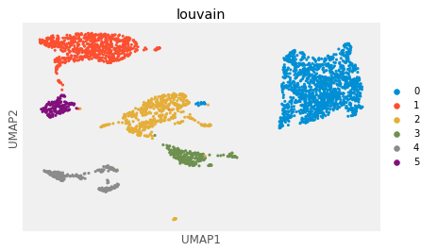
K-Means clustering of 7 MOUSE cells using UMAP components (ADJUSTED RAND SCORE=0.91)

Slide 15
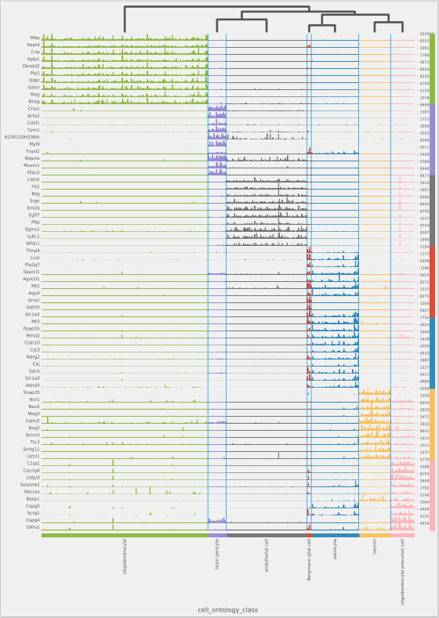
dendrogram showing differentially expressed genes for each cell type

Slide 16
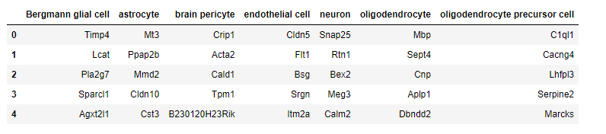
TABLE showing 5 differentially expressed genes for each cell type

Slide 17
Conclusion
A pipeline to analyze differentially expressed genes in 7 different mouse types of cells was set up. This pipeline effectively uncover differentially expressed genes (the most important) in different types of cells. It was established that the Louvain clustering algorithm is much more effective in comparison with K-means in clustering data containing single cell RNAseq data.

